Slide 1

CLOUD COMPUTING COURSE PRESENTATION - PARTHENOPE
Towards Adaptive and Scalable Hierarchical
Federated Learning
Simone Cioffi
Mat : 0120000321
Marco Lettiero
Mat : 0120000286
Daniele d’Alessandro
Mat : 0120000310

Slide 2
01
Introduction - Federated Learning
02
Introduction - Hierarchical FL
03
Microsoft Azure
Contents
04
Problem Statement
05
Proposed Method
06
An Alternative to Azure - Docker
07
Experimental Setup
08
Results
09
Conclusions & Future Works

Slide 3
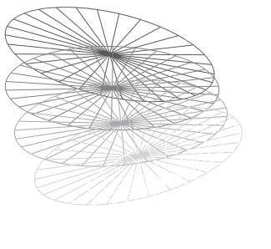

INTRODUCTION

Slide 4
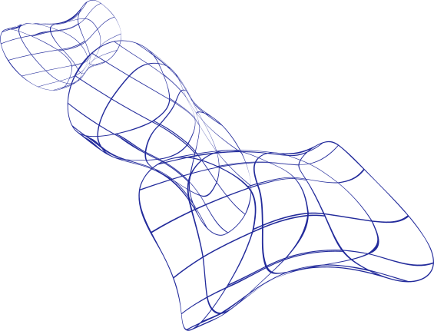
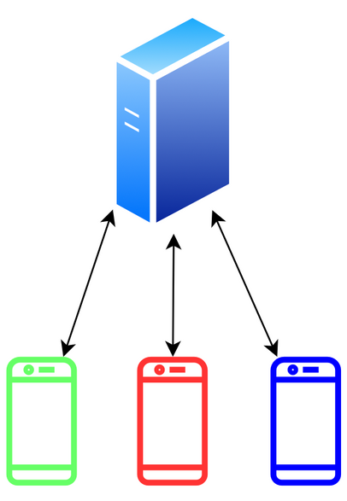
Cloud computing Course Presentation - Parthenope
Federated Learning
The Federated Learning (FL) is a new approach for Machine Learning models. Giving a new collaborative method for model training using decentralized devices without explicit data-sharing.
This techinque trains the local models from client devices that is aggregated to the central node that produce the global model. FL offers several key advantages:
Data privacy and access, enhances data privacy and security by keeping raw data localized.
Lower overhead and computational demands, this is highly reduced because only compact model updates, rather than bulky raw data, are transmitted.
Robustness, by decentralizing the training process, the risk of a single point of failure is mitigated.
Notes:
Let's start by understanding the foundation of our work: Federated Learning.
Federated Learning represents a relatively new and powerful approach to Machine Learning. Traditionally, training models required gathering all data in a central location, which often raised significant privacy and logistical concerns. FL, however, offers a collaborative method where models are trained using decentralized devices – like your mobile phones or local sensors – without the need to explicitly share raw data.
The core idea is simple: individual client devices train their local models using their own data. Then, instead of sending their sensitive raw data back to a central server, they only transmit compact model updates – essentially, the learned parameters or weights. These updates are then aggregated at a central node to produce a more robust and generalized global model.
This technique offers several key advantages, making it particularly relevant today:
Firstly, Data Privacy and Access: FL significantly enhances data privacy and security by ensuring that raw data remains localized on the client devices. This reduces the risk of data breaches and helps comply with strict data protection regulations. It also allows us to leverage diverse and larger datasets that might otherwise be inaccessible due to privacy concerns.
Secondly, Lower Overhead and Computational Demands: Since only small model updates, rather than bulky raw data, are transmitted, the communication overhead and computational demands on the network are greatly reduced. This also enables on-device learning and edge AI, leading to lower latency and improved real-time performance.
And finally, Robustness: By decentralizing the training process, FL mitigates the risk of a single point of failure. If one device goes offline, the overall training process can continue, enhancing the system's overall resilience.
As you can see from the diagram, the standard FL setup involves direct communication between each client and a single central server for aggregation.

Slide 5
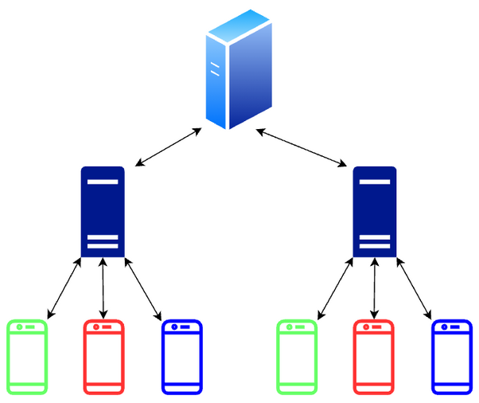
Cloud computing Course Presentation - Parthenope
Hierarchical FL
While traditional FL demonstrates significant potential in collaborative model training, faces critical challenges when scaled to large number of Geographically remote clients.
Hierarchical Federated Learning (HFL) offers a practical solution by introducing an intermediate layer of edge servers or aggregators. Instead of all clients communicating directly with the central server, only a smaller group of edge nodes.
This layered approach not only reduces communication overhead but also enhances scalability and robustness by allowing local aggregation among geographically or logically grouped clients
Notes:
While traditional Federated Learning offers immense potential, it faces critical challenges when scaled to a very large number of geographically dispersed clients. Imagine thousands or even millions of devices all trying to communicate directly with one central coordinator – this can lead to significant communication overhead, network congestion, and reduced scalability.
This is where Hierarchical Federated Learning, or HFL, comes in as a practical and elegant solution. HFL introduces an intermediate layer of 'edge servers' or 'aggregators' between the clients and the central server.
Instead of every client communicating directly with the central server, clients now connect to a smaller, more manageable group of these edge nodes. These edge servers perform an initial, local aggregation of model updates from their assigned clients. Only these intermediate, partially aggregated models are then sent to the central coordinator for final global aggregation.
This layered approach offers several key benefits:
Reduced Communication Overhead: By performing local aggregation at the edge, HFL significantly reduces the volume of traffic that needs to be processed by the central server, alleviating network bottlenecks.
Enhanced Scalability and Robustness: It allows for local aggregation among geographically or logically grouped clients, making the system more scalable and resilient. Edge servers can also buffer updates and handle brief network disruptions, improving fault tolerance.
Essentially, HFL optimizes the communication flow, making federated learning feasible and efficient in large-scale, real-world deployments such as smart cities or IoT networks, where data privacy, efficient communication, and resilience are paramount.

Slide 6

Cloud computing Course Presentation - Parthenope
Microsoft Azure
Microsoft Azure is a cloud computing platform and service developed by Microsoft, launched in 2010. It offers a globally distributed infrastructure that supports a wide range of cloud services, including
Virtual Machines.
App Services.
SQL & NoSQL Databases.
API services.
AI, Machine Learning & DevOps Tools.
Azure enables businesses to build, deploy, and manage applications efficiently across a global network of Microsoft-managed data centers. It is used by companies of all sizes to enhance scalability, reduce costs, and accelerate innovation.

Slide 7
Problem Statement & Solution

Slide 8
Cloud computing Course Presentation - Parthenope
Problem Statement
Current HFL limitations:
Existing HFL frameworks are fundamentally limited by their reliance on a static pool of edge servers.
This static allocation cannot accommodate the dynamic nature of edge environments, where client numbers, data rates, and computational requirements vary significantly over time.
Consequences of Static HFL:
Economic Inefficiency: Resource underutilization during low activity periods leads to unnecessary energy consumption.
Performance Degradation: During peak workloads, static resources become overwhelmed, causing increased latency, dropped updates, and degraded model convergence.
Limited Fault Tolerance: Failure of a static edge server can disrupt a large subset of clients, interrupting training and introducing inconsistencies.
Notes:
While HFL offers significant advantages over traditional Federated Learning, existing HFL frameworks face a fundamental limitation: their reliance on a static pool of edge servers. This means that the number of edge servers is fixed, regardless of the actual demand or workload.
This static allocation is a major hurdle because it simply cannot accommodate the inherently dynamic nature of real-world edge environments. In practice, the number of client devices participating in federated learning, the data rates they generate, and their computational requirements can fluctuate significantly over time. A static infrastructure is ill-equipped to handle these variations.
The consequences of this static approach are quite severe and can be broadly categorized into three areas:
Firstly, Economic Inefficiency: When client activity is low, a fixed number of edge servers leads to significant resource underutilization. This translates directly into unnecessary energy consumption and wasted operational costs, as resources are kept running even when they are not fully needed.
Secondly, Performance Degradation: Conversely, during periods of peak workload, these static resources can become overwhelmed. This results in increased latency for model updates, potentially dropped updates, and ultimately, degraded model convergence, meaning the global model takes longer to train or doesn't achieve optimal performance.
And finally, Limited Fault Tolerance: In a static setup, if a single edge server fails, it can disrupt a large subset of clients that were assigned to it. This interrupts the training process for those clients and can introduce inconsistencies into the overall federated learning operation, reducing the system's robustness.
Therefore, the critical challenge lies in designing an HFL framework that can dynamically adapt its edge server resources to meet real-time demand, overcoming these inefficiencies and limitations.

Slide 9
Cloud computing Course Presentation - Parthenope
Proposed Method
Our proposed method introduces an HFL architecture with a built-in auto-scaling mechanism for edge servers, designed to efficiently manage communication overhead and dynamically adapt to varying client numbers without external orchestrators like Kubernetes.
Three-Layered Architecture:
Clients (Base Layer): End-user devices holding local datasets. They train a local model (tinyVGG in this study) and transmit model updates (weights) to a designated edge server. Random data partitioning emulates heterogeneous real-world data distributions.
Edge Servers (Intermediate Layer): Act as local aggregators. Each collects model updates from a subset of clients and performs initial aggregation to produce an intermediate model. The number of active edge servers is dynamically controlled by the auto-scaling mechanism based on system demands.
Coordinator (Top Layer): A central server overseeing the federated learning process. Responsible for assigning newly connected clients to suitable edge servers and performing global aggregation upon completion of intermediate FL sessions.
Notes:
Now, let's move on to our proposed solution. Recognizing the limitations of static HFL frameworks, our method introduces a novel Hierarchical Federated Learning architecture with a built-in auto-scaling mechanism for edge servers. The key here is its ability to efficiently manage communication overhead and dynamically adapt to varying client numbers, crucially, without the need for external orchestrators like Kubernetes.
Our architecture is structured in three layers, designed to optimize the federated learning process:
At the base, we have the Clients. These are the end-user devices holding the local datasets. Each client is responsible for training a local model—in our study, we used a lightweight tinyVGG model—and then transmitting only the model updates, specifically the weights, to a designated edge server. To simulate real-world conditions, we implemented random data partitioning, which emulates the heterogeneous data distributions often found in real-world scenarios.
In the intermediate layer, we have the Edge Servers. These servers act as local aggregators. Each edge server collects model updates from a subset of clients it serves and performs an initial aggregation to produce an intermediate model. A critical aspect of our design is that the number of active edge servers is dynamically controlled by our auto-scaling mechanism, responding in real-time to system demands.
And finally, at the top, we have the Coordinator. This central server oversees the entire federated learning process. Its responsibilities include assigning newly connected clients to appropriate edge servers and performing the final, global aggregation once the intermediate FL sessions at the edge servers are completed.
This three-layered approach provides a flexible and efficient structure that forms the backbone of our adaptive HFL system.

Slide 10
Cloud computing Course Presentation - Parthenope
Proposed Method
Auto-Scaling System for Edge Servers:
Client Connection Process: Clients query the coordinator for an available edge server's IP address, unaware of the hierarchical topology.
Horizontal Scaling Policy: The coordinator leverages client requests to dynamically instantiate new edge servers as the number of requests grows.
Robustness & Management: The coordinator tracks assignments to ensure system robustness, enabling client reconnections and managing edge server failures.
Cloud Benefits: Greatly benefits from cloud computing solutions (e.g., Azure VMSS) for rapid VM instantiation using "golden images" and integrated distributed storage services (e.g., Azure Blob Storage) for crash recovery.
Notes:
The process begins with the Client Connection Process. When a client wants to join the federated learning process, it queries the coordinator for an available edge server's IP address. From the client's perspective, the hierarchical topology is largely transparent; they simply request a connection endpoint.
What happens behind the scenes is our Horizontal Scaling Policy. The coordinator actively leverages these client requests as a real-time indicator of demand. As the number of incoming client requests grows, the coordinator dynamically instantiates new edge servers to accommodate the increased load. Conversely, when demand decreases, underutilized edge servers can be retired, ensuring efficient resource allocation.
To ensure the system remains robust and resilient, the Coordinator also manages Robustness & Management. It continuously tracks the assignments of clients to edge servers. This capability allows for seamless client reconnections if an edge server temporarily goes offline, and it facilitates the effective management of edge server failures, minimizing disruption to the overall training process.
Our design greatly benefits from the capabilities offered by modern cloud computing solutions. Platforms like Azure Virtual Machine Scale Sets (VMSS) are ideal for rapid virtual machine instantiation using pre-configured 'golden images.' Additionally, integrated distributed storage services, such as Azure Blob Storage, provide a reliable mechanism for crash recovery and persistent storage of model updates. This integration with cloud features enables us to achieve truly elastic and resilient HFL deployments.

Slide 11
Cloud computing Course Presentation - Parthenope
An Alternative to Azure - Docker
The auto-scaled system was designed to greatly benefit from cloud computing solutions like Azure VMSS, which allows for quick instantiation of virtual machines.
The experiments were limited by the resources available under the Azure for Students plan, which allows only three virtual machines and three public IP addresses. This quota limit made it impractical to simulate the dynamic creation of numerous edge servers required for comprehensive testing of the auto-scaling mechanism.
To circumvent these quota limits, the experiments were conducted in a fully simulated environment on a single local host machine, Docker containers were used to host all required entities: the coordinator, multiple edge servers, and multiple clients. Each Docker container was allocated four dedicated CPU cores, and Docker's networking features were also utilized to simulate a real network with existing DNS
Notes:
While our auto-scaled system was conceptually designed to greatly benefit from robust cloud computing solutions like Azure VMSS, which allows for quick instantiation of virtual machines, we faced a practical limitation during our experimental phase.
The experiments were constrained by the resources available under the 'Azure for Students' plan. This plan, while generous for educational purposes, allowed us only three virtual machines and three public IP addresses. This quota limit made it impractical to realistically simulate the dynamic creation of numerous edge servers, which is a core component of our auto-scaling mechanism, and is essential for comprehensive testing.
To circumvent these quota limits and still validate our proposed auto-scaling mechanism effectively, we decided to conduct our experiments in a fully simulated environment on a single local host machine. For this, we extensively utilized Docker containers.
Docker containers were used to host all the required entities of our hierarchical federated learning system: the coordinator, multiple edge servers, and multiple clients. This allowed us to create and manage numerous instances of these components, simulating the dynamic nature of a large-scale deployment. Each Docker container was allocated four dedicated CPU cores to ensure consistent performance for each simulated entity. Furthermore, Docker's networking features were leveraged to simulate a real network with existing DNS, providing a realistic testing ground despite being contained within a single physical machine.
This approach allowed us to thoroughly test and demonstrate the auto-scaling capabilities and the overall behavior of our HFL framework, overcoming the infrastructural limitations and proving its viability in a controlled, replicable environment.

Slide 12
Cloud computing Course Presentation - Parthenope
Experimental Setup
Experiments and simulations were conducted on a local host machine equipped with an Intel Core i9-13900K CPU (24 cores, 32 threads) and 32 GB of RAM.
Deep Learning Model & Training:
Model: tinyVGG, a lightweight version of VGG.
Training: Performed using CPU only to simulate typical scenarios where clients have limited computational resources.
Client Training: Each client performed a single local training epoch per round.
Batch Size: 64.
Dataset: 10% of the Fashion-MNIST training dataset (i.e., 6,000 samples).
Convergence: tinyVGG's simplicity allowed federated training to converge in approximately three rounds.
All work and code are openly available on GitHub.
Notes:
All our experiments and simulations were conducted on a robust local host machine. This machine was equipped with an Intel Core i9-13900K CPU, which boasts 24 cores and 32 threads, along with 32 GB of RAM. This powerful local environment allowed us to run numerous Docker containers, effectively simulating a large-scale distributed system.
For our deep learning model and training, we made specific choices to reflect realistic federated learning scenarios:
We used tinyVGG, a lightweight version of the well-known VGG model, as our deep learning model.
Crucially, all training was performed using CPU only. This decision was deliberate, aiming to simulate typical scenarios where client devices might have limited computational resources, often lacking dedicated GPUs.
Each client performed a single local training epoch per round, which is a common practice in federated learning to balance communication overhead with local computation.
We used a batch size of 64 for our training.
The dataset we utilized was 10% of the Fashion-MNIST training dataset, amounting to 6,000 samples. This provided a sufficiently diverse yet manageable dataset for our experiments.
Due to the relative simplicity of the tinyVGG model and the dataset, our federated training setup converged in approximately three rounds, allowing for efficient experimentation.

Slide 13
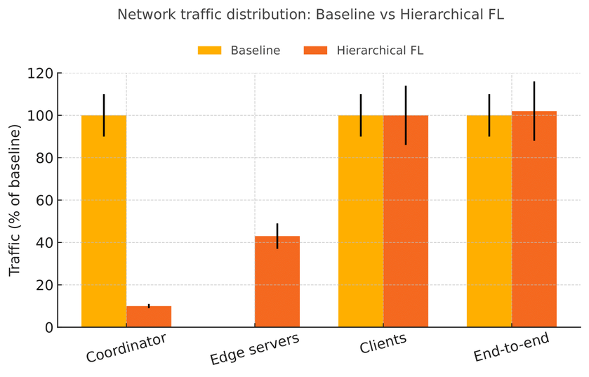
Cloud computing Course Presentation - Parthenope
Results
On-demand edge servers significantly reduced the volume of traffic processed by the central coordinator compared to a flat architecture.
Traffic Distribution Comparison (Baseline vs. HFL):
Coordinator: Handles a small fraction of the traffic in HFL, offloading roughly 90% of the upstream volume (compared to 100% in baseline).
Edge Servers: Absorb about half of the baseline throughput.
Clients: Continue to transmit essentially the same amount of data as in the baseline, imposing no extra burden on users.
Total End-to-End Traffic: Remained statistically identical to the baseline.
The communication load is cleanly partitioned across the edge tier, and the coordinator is virtually unburdened, with negligible overhead introduced by the hierarchical design.
Notes:
Plot on the bottom right shows also the error bars computed during the simulation, which shown a standard deviation of about 10%
Now, let's turn our attention to the results of our experiments, which illustrates the network traffic distribution. Our primary goal was to significantly reduce the communication overhead at the central coordinator.
As you can see from the bar chart, we compared the 'Baseline' (representing a flat, traditional Federated Learning architecture) with our 'Hierarchical FL' approach. The y-axis shows the traffic as a percentage of the baseline.
The most striking result is regarding the Coordinator. In the baseline, the coordinator handles 100% of the upstream traffic. However, with our on-demand edge servers, the volume of traffic processed by the central coordinator was significantly reduced. Our Hierarchical FL framework offloaded approximately 90% of the upstream volume from the coordinator, leaving it to handle only a small fraction of the total traffic. This is a massive improvement in managing central bottleneck.
Next, looking at the Edge Servers, they absorbed about half of the baseline throughput. This demonstrates how the intermediate layer effectively distributes the communication load.
Importantly, for the Clients, the amount of data they needed to transmit remained essentially the same as in the baseline. This means our hierarchical approach imposes no extra burden or changes on the end-user devices, which is critical for practical adoption.
Finally, when we look at the Total End-to-End Traffic, it remained statistically identical to the baseline. This is a crucial finding because it confirms that while we drastically reduced the load on the central coordinator, we didn't introduce any significant overhead to the overall system. The communication load is cleanly partitioned across the edge tier, and the coordinator is virtually unburdened, with negligible overhead introduced by the hierarchical design.

Slide 14
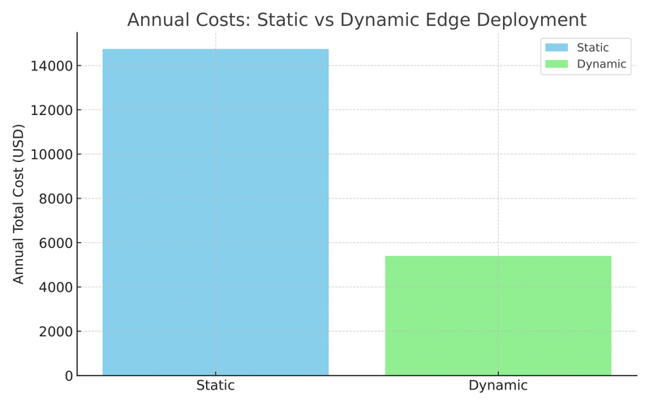
Cloud computing Course Presentation - Parthenope
Results
Cost Analysis based on public cloud pricing (Azure).
Assumptions for Cost Calculation:
Edge VM: ~0.8 USD/hour (four cores).
Additional daily cost: ~1 USD for local storage and static public IP.
Static vs. Dynamic Deployment (Two Edge Servers):
Static Deployment (24h/day): Annual Cost: ~15,000 USD.
Our Dynamic Allocation (Estimated 8h/day): Annual Cost: ~6,000 USD.
Annual Projected Savings: ~10,000 USD.
Notes:
Estimation are ceiled.
Beyond performance, another key aspect of our research was to demonstrate the economic benefits of our dynamic allocation strategy. Here we presents a cost analysis based on public cloud pricing, specifically using Azure's rates.
For our cost calculations, we made realistic assumptions: an edge Virtual Machine (VM) with four cores was estimated to cost approximately 0.8 USD per hour , with an additional daily cost of about 1 USD for local storage and a static public IP.
We then compared two deployment scenarios for two edge servers:
Static Deployment: If these two edge servers were to run continuously, 24 hours a day, their estimated annual cost would be around 15,000 USD. This represents the cost of a traditional, non-adaptive HFL setup.
Our Dynamic Allocation: In contrast, our proposed method, which dynamically scales edge servers based on demand, resulted in an estimated operational time of only 8 hours per day. With this dynamic allocation, the projected annual cost significantly drops to approximately 6,000 USD.
This comparison reveals a compelling annual projected savings of roughly 10,000 USD. This clearly demonstrates the substantial economic value of implementing an elastic scaling mechanism for edge servers in Hierarchical Federated Learning. By only paying for the resources when they are actively needed, it is possible to achieve significant cost efficiencies while maintaining performance.

Slide 15
Conclusions

Slide 16
Cloud computing Course Presentation - Parthenope
Conclusions & Future Works
Summary of Contributions:
Presented the first auto-scaled HFL framework that dynamically instantiates and retires edge servers based on real-time demand.
Demonstrated significant traffic reduction at the central coordinator (90% offload) with negligible end-to-end overhead.
Showed potential annual economic savings compared to static deployments.
Contributed a lightweight orchestration mechanism (no external orchestrator needed), an explicit analytical formulation of dynamic edge aggregation, and an open-source reference implementation.
Future Directions:
Migrate the prototype to Azure VMSS to validate auto-scaling on real cloud infrastructure.
Extend the current three-tier hierarchy to multi-tier topologies for fine-grained aggregation.
Notes:
To conclude our presentation, let's summarize our key contributions and outline our future work.
Our work has successfully addressed significant challenges in large-scale Federated Learning by introducing the first auto-scaled Hierarchical Federated Learning framework. This framework dynamically instantiates and retires edge servers based on real-time demand, a critical advancement for adaptive and efficient FL.
Through our comprehensive evaluation, we demonstrated a significant traffic reduction at the central coordinator, achieving approximately 90% offload of upstream traffic, while maintaining negligible end-to-end overhead across the entire system. This proves the effectiveness of our hierarchical design in alleviating network bottlenecks.
Furthermore, our cost analysis revealed potential annual economic savings, projecting approximately $10,000 in savings compared to traditional static deployments. This highlights the practical and financial benefits of adopting our dynamic allocation strategy.
Beyond these tangible results, we also contributed a lightweight orchestration mechanism that operates without the need for external orchestrators like Kubernetes. We provided an explicit analytical formulation of dynamic edge aggregation and, importantly, an open-source reference implementation for the community.
Looking ahead, our future work is focused on several directions:
Firstly, we aim to migrate our prototype to Azure VMSS to fully validate the auto-scaling mechanism on a real cloud infrastructure, moving beyond our simulated environment.
Secondly, we plan to extend the current three-tier hierarchy to multi-tier topologies. This will enable even finer-grained aggregation and potentially unlock new optimization opportunities for very large and diverse federated learning scenarios.

Slide 17
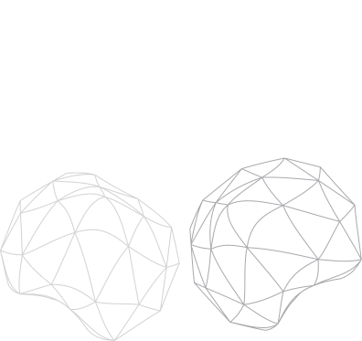

Thank you for your attention!

